Slide 1

Fundamentals of RM
RM System and Process
Leadership in RM
Incident Investigation
RM Tools & Challenges
RM in Industry
People & Org.
Applications & Perspectives
On Becoming a Leader in Safety and Risk Management
ENGG 404
Chapter 1.2
What is PEAP? Why is PEAP Important?
1
Notes:
ENGG404 Lecture 00 - Day 1
2012 Fall
1
1

Slide 2
Learning Outcomes
By the end of this lecture, you will be able to:
Explain what PEAP is.
Analyze a loss incident and conclude the impacts on PEAP.
Correlate the importance of PEAP to managing risks in order to prevent losses.
Chapter 1.2: What is PEAP? Why PEAP?
2
Notes:
2

Slide 3
PEAP is …
People
Worker or public
Injury, fatality, long term illness
Assets
Infrastructure
Equipment
Produced goods
Reputation & Social License
Environment
Impacts or emissions to air, water, land
On site, off site
Productivity
Barrels of oil per day
Rail cars loaded and shipped
Can be intermittent or ongoing
Chapter 1.2: What is PEAP? Why PEAP?
3

Slide 4
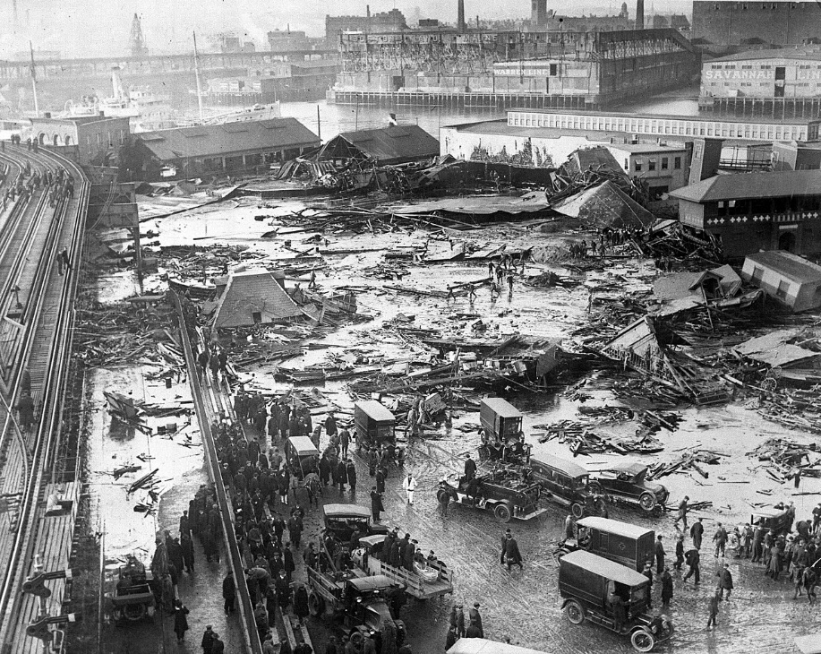
Example of PEAP Losses
Great Boston Molasses Flood of 1919
People: 21 people drowned. 150 injured
Environment: Contamination of land & water
Assets: 2.3 million US gallon tank destroyed and molasses lost
Production: Ongoing loss of future rum production
Image from: https://en.wikipedia.org/wiki/Great_Molasses_Flood#/media/File:BostonMolassesDisaster.jpg
Chapter 1.2: What is PEAP? Why PEAP?

Slide 5
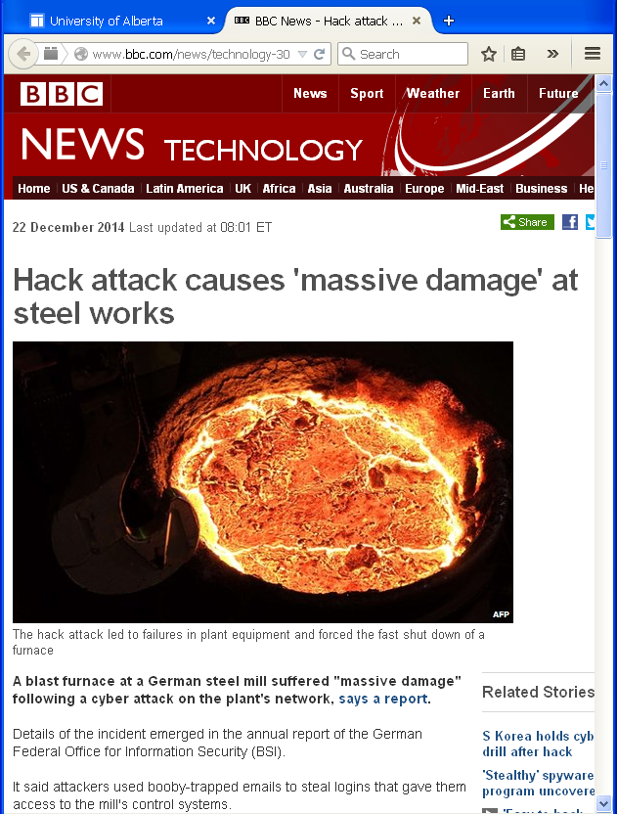
Emerging Concerns: PEAP and S&V
http://www.bbc.co.uk/news/technology-30575104
Security and Vulnerability | Terrorism and violent attacks Theft, fraud, and embezzlement Unauthorized access to computer systems including network sabotage and espionage
Chapter 1.2: What is PEAP? Why PEAP?
5
Notes:
5

Slide 6
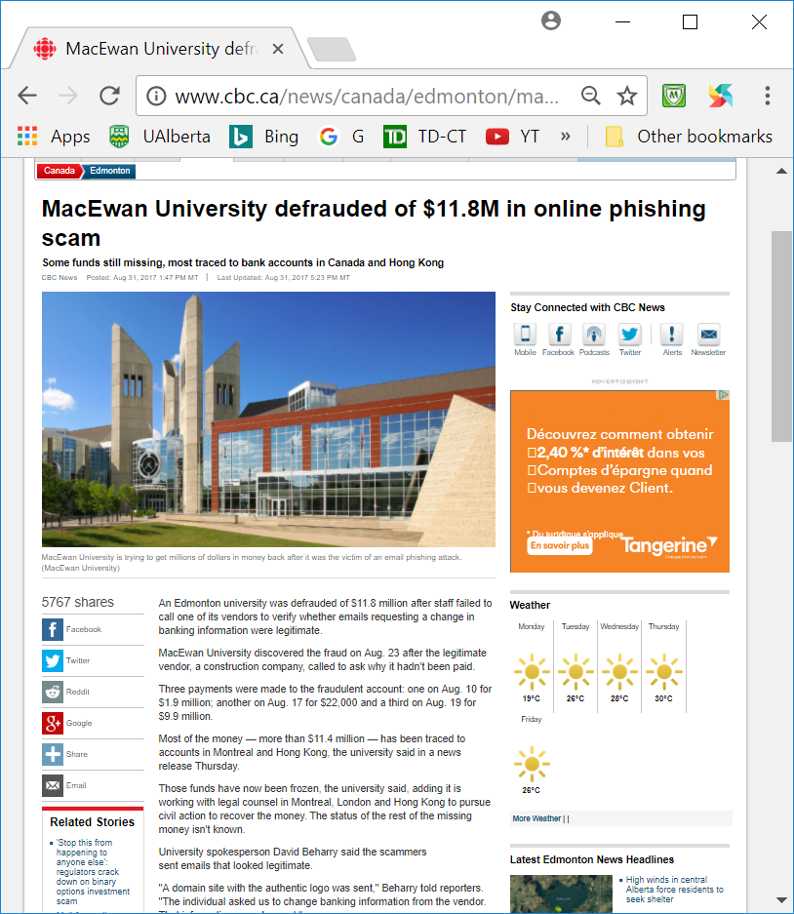
Emerging Concerns: PEAP and S&V
http://www.cbc.ca/news/canada/edmonton/macewan-university-phishing-scam-edmonton-1.4270689
Security and Vulnerability | Phishing and scamming
Chapter 1.2: What is PEAP? Why PEAP?
6
Notes:
6

Slide 7
Importance of PEAP – Concept and Quantification:
It quantifies the extent of a loss incident
Provides the scope of interests for a risk management system
PEAP losses are reduced with the application of a sound risk management system!
Illustrates that P(eople) losses are not the only important ones
It helps us to avoid and minimize loss!
Chapter 1.2: What is PEAP? Why PEAP?

Slide 8
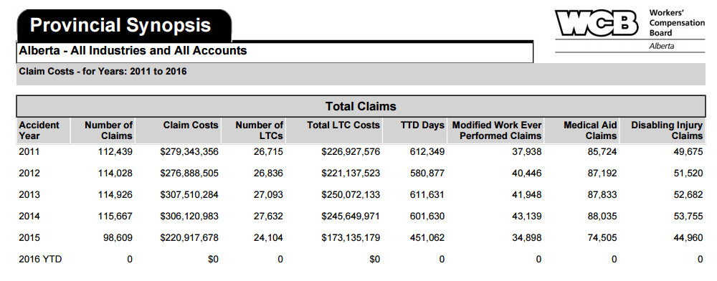
Closer to Home: Alberta Workplace Injury Statistics:
In Alberta, a person is killed on-the-job every third day.
About 120 - 130 workers are seriously injured every day
Direct transaction claim costs ~$200 to $300 million per year!
Chapter 1.2: What is PEAP? Why PEAP?
8
Notes:
8

Slide 9
What have we learned?
Every third day in Alberta, a worker doesn’t come home
Implementing a sound and thorough risk management program helps to avoid PEAP losses
As an engineer, you will likely be managing risks with employees, and contractors
In areas such as design, budget, schedule, operations, and maintenance
You ALWAYS need to consider the potential PEAP losses in each area before making any decision!
Avoidance of loss or minimizing loss is the same as … maximizing profit.
Chapter 1.2: What is PEAP? Why PEAP?
9
Notes:
9

